Slide 1
AIaaS
Artificial Intelligence as a Service
[Empowering Businesses with Artificial Intelligence]

Slide 2
Introduction
Definition of Service
Definition of AIaaS

Slide 3
Types of AIaaS offerings
Natural language processing (NLP)
Image recognition
Predictive analytics
Speech-to-text , …
Translation services

Slide 4
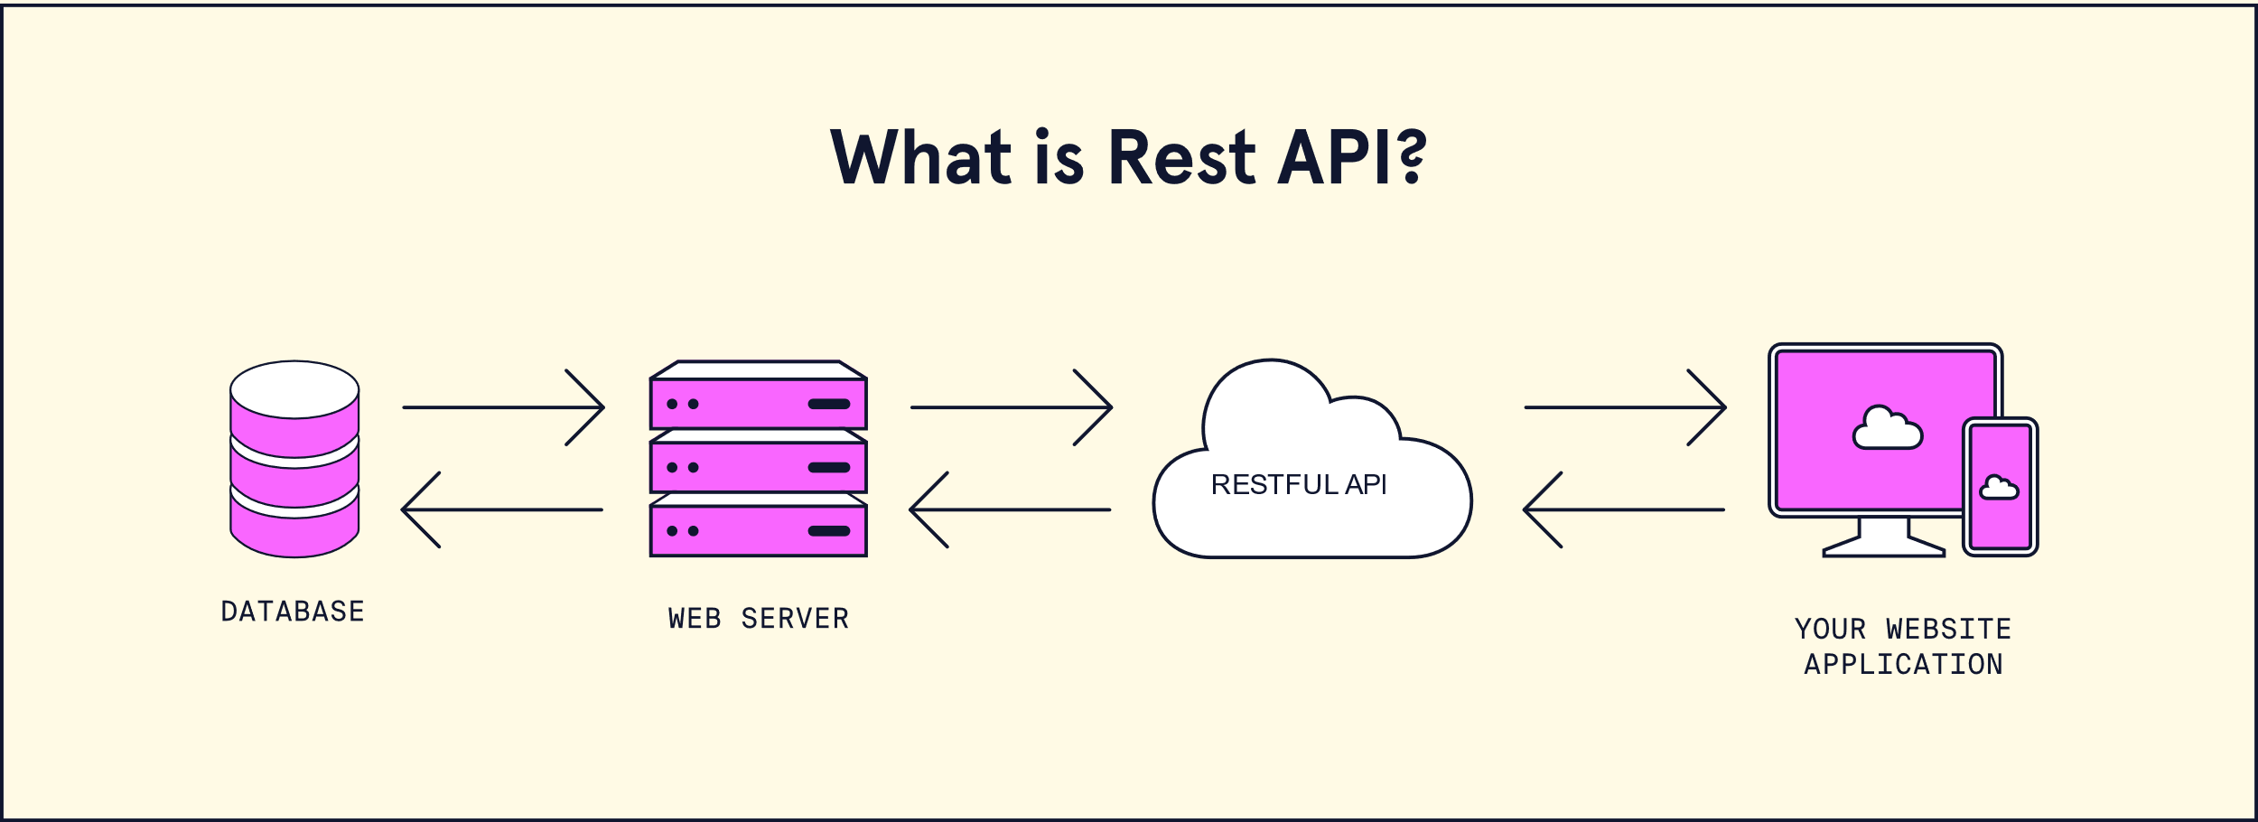
How AIaaS works with Clients
API
RestFull API
RPC (e.g: gRPC)
etc
SDK
Specific Programming language(python,c++,…)
Rest , …
Ref: https://www.codecademy.com/article/what-is-rest

Slide 5
Examples of AIaaS providers
Amazon Web Services
Google Cloud
Microsoft Azure
IBM Watson

Slide 6
Advantages of using AIaaS
Scalability
Flexibility
Cost-effectiveness
Faster time-to-market
Access to advanced AI technologies
Speed
Usability

Slide 7

Challenges of using Providers
Data privacy and security concerns
Integration with existing systems
Compatibility issues with legacy software
Dependence on third-party providers

Slide 8
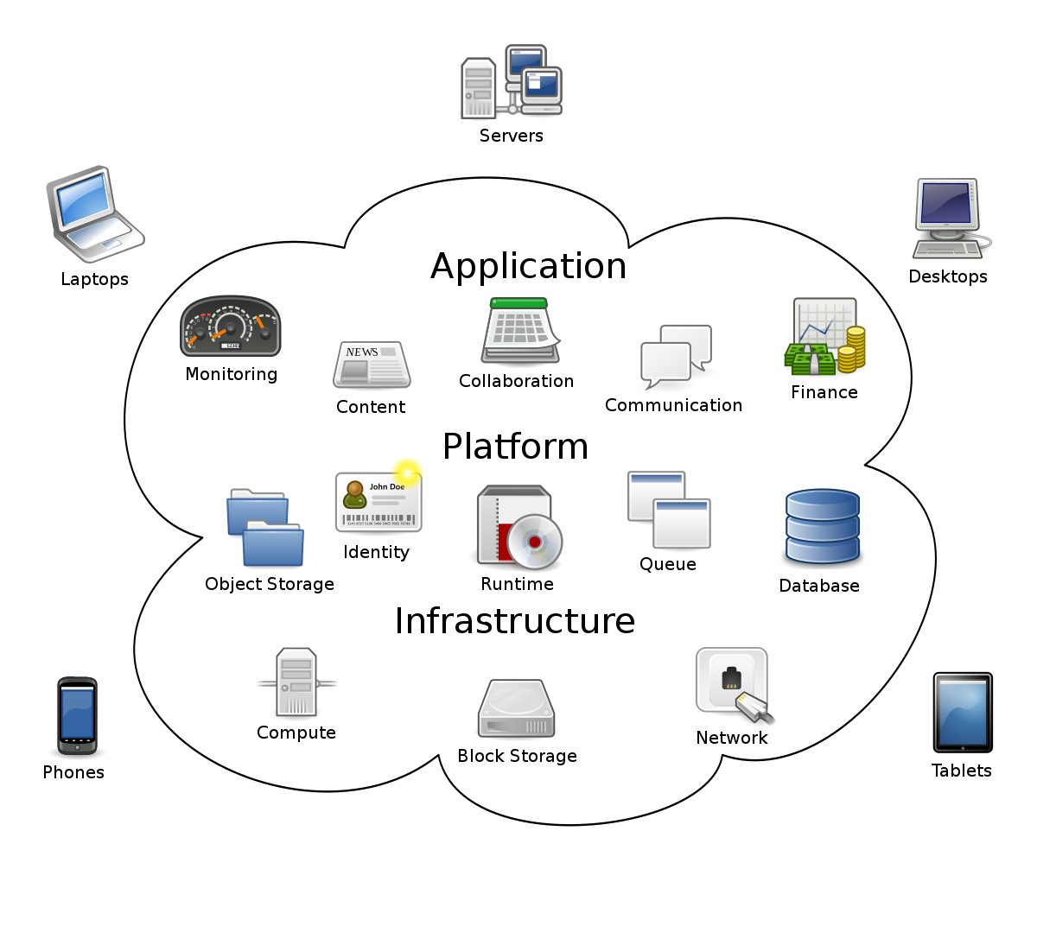
ShowCase
Ref: https://en.wikipedia.org/wiki/Cloud_computing

Slide 9
Ethical considerations of AIaaS
Algorithmic
Third-Party
Transparency and interpretability of AI models

Slide 10
Real-world examples of AIaaS
Bots
Logistics
Language Translation
Assistance
Agents
Converters
Image improvers
etc

Slide 11
The future of AIaaS
Increasing adoption in different industries
Emergence of new AI technologies
Advancements in natural language processing and computer vision

Slide 12
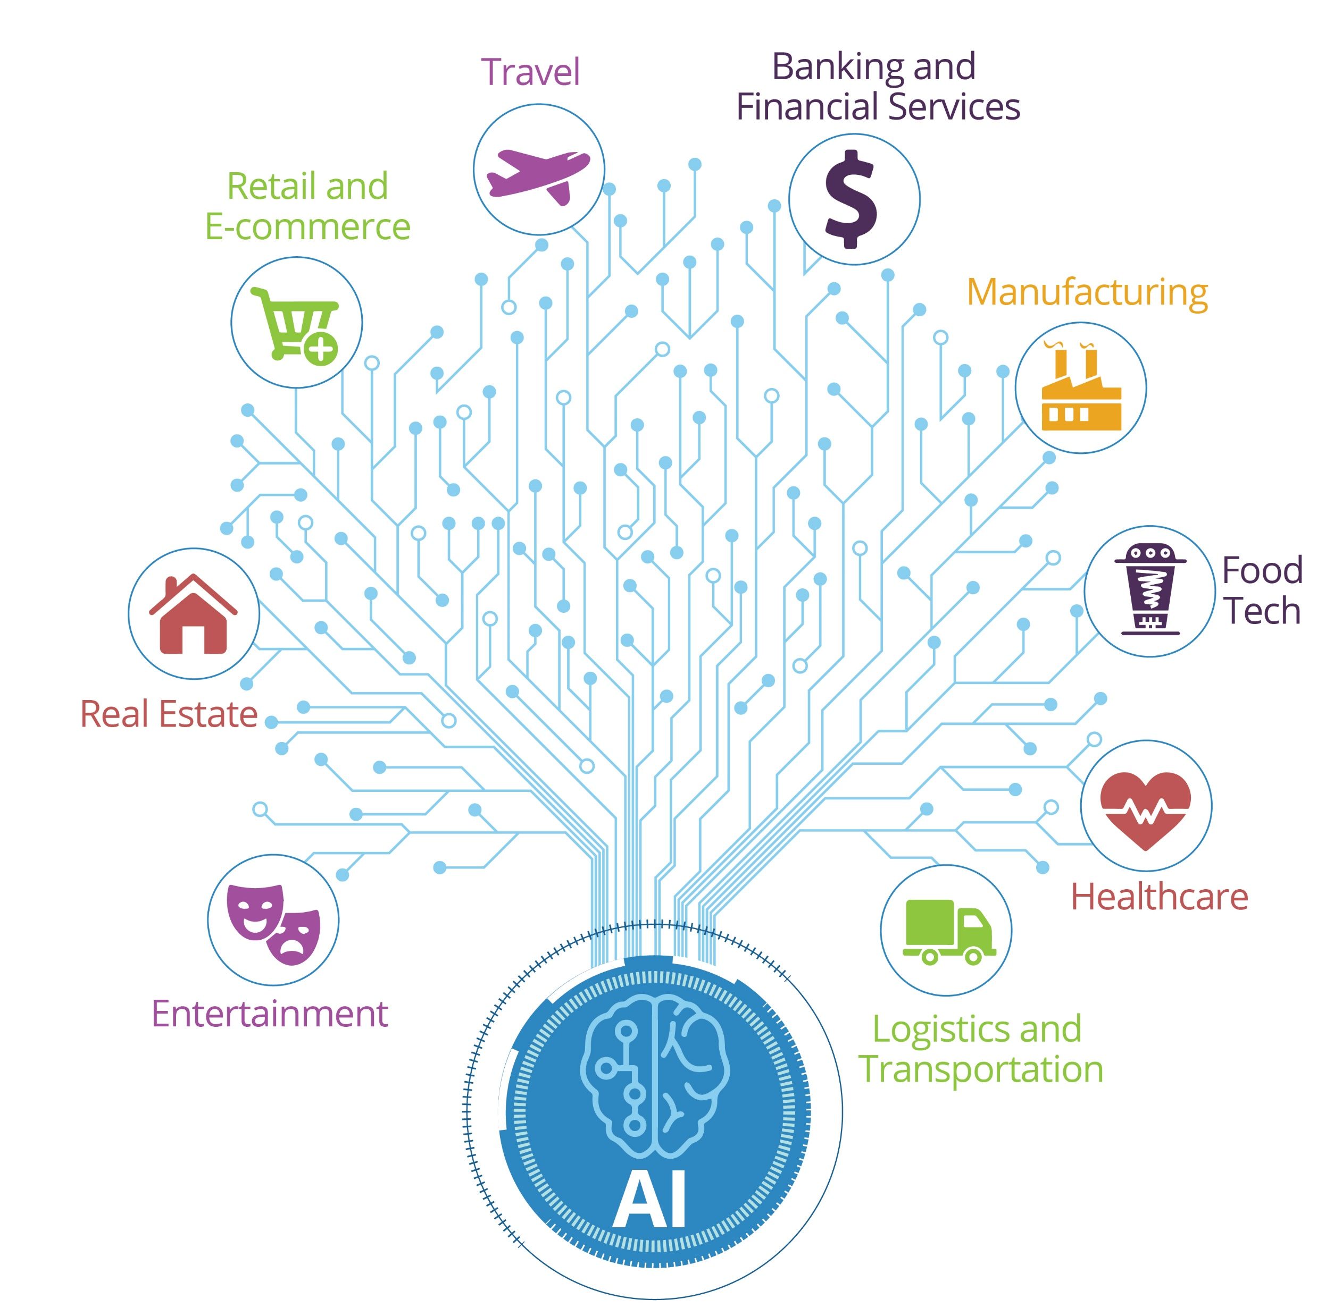
Use cases of AIaaS
Healthcare
Retail
Manufacturing
Finance
Transportation
etc

Slide 13
Success stories of AIaaS
Netflix recommendation engine
analyze user data
providing relevant recommendations
PayPal fraud detection system
analyzes patterns, user behavior, and transaction data
fraudulent activities
Coca-Cola personalized marketing campaigns
analyze consumer data
strengthens brand connections and fosters customer loyalty

Slide 14
Risk of not adopting AIaaS
Falling behind in the competition
Losing market share to AI-driven companies
Inability to keep up with customer expectations

Slide 15
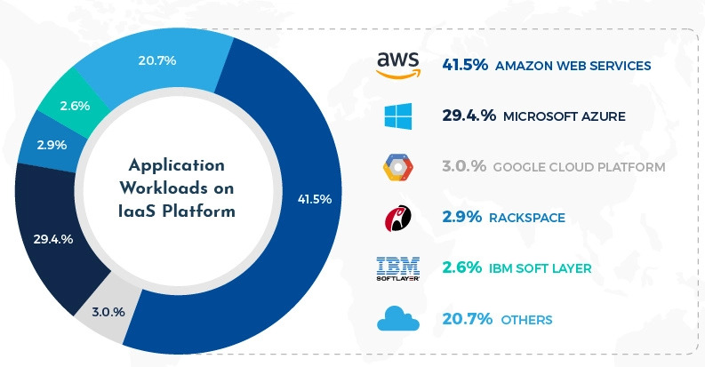
IaaS sizes
Ref: https://www.visualcapitalist.com/stats-amazon-dominance-cloud/
Notes:
https://www.visualcapitalist.com/stats-amazon-dominance-cloud/

Slide 16
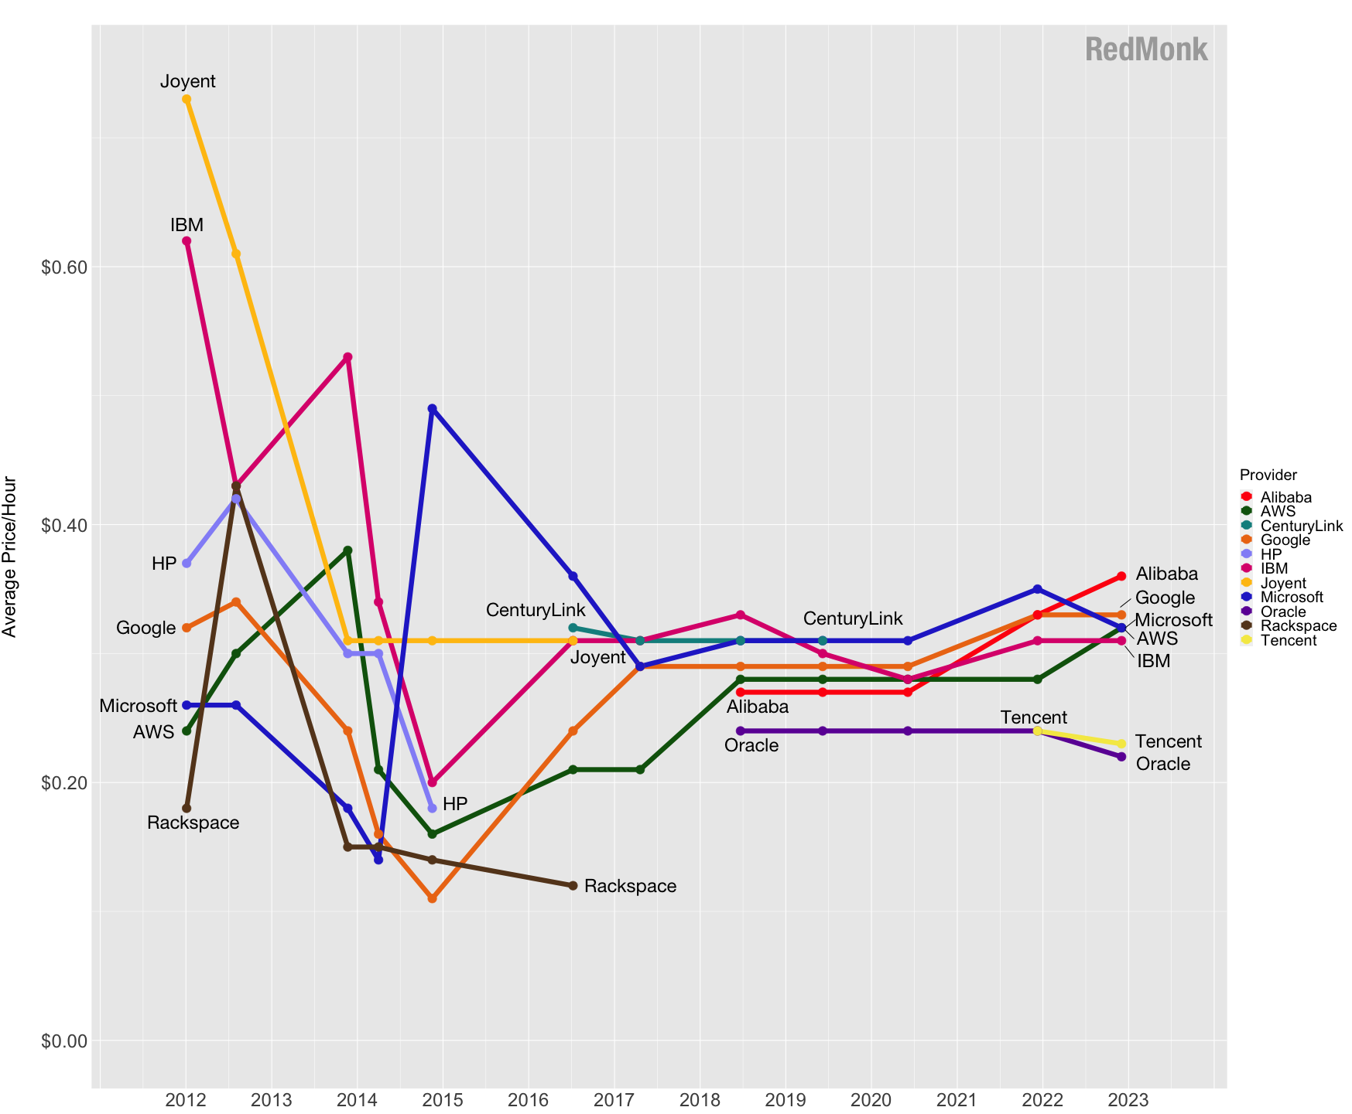
Overview all provider prices(Average)
More info: https://redmonk.com/rstephens/2023/04/11/iaaspricing2022/
Notes:
https://redmonk.com/rstephens/2023/04/11/iaaspricing2022/

Slide 17
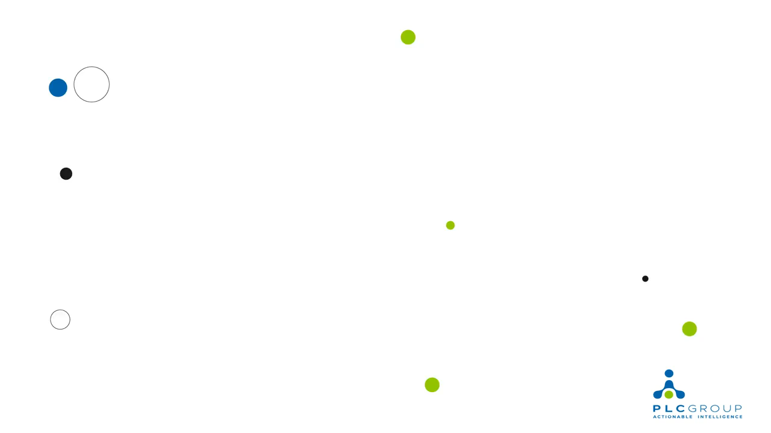
Notes:
Ref: https://www.youtube.com/watch?v=EdcbmXv5PeM

Slide 18
Good to know
AWS
pay-as-you-go model
good free services too , link: https://shorturl.at/kmxM8
Pay less by using more (lower cost when increase using!)
Calculate online your requirements: https://calculator.aws/
Step1: select region
Step2: configure your system
Microsoft Azure
Plans: https://azure.microsoft.com/en-us/pricing/#product-pricing
GCP
Only pay for what you use , link: https://cloud.google.com/pricing/list
$300 in new customers! Free credit.
Notes:
https://cloud.google.com/pricing

Slide 19
Conclusion
- Recap of the key points
- Encouragement to consider AIaaS for business operations
- Contact information for further inquiries: - Heydar.mahmoodi75@gmail.com
- also you can download slides from presentation dir:
- https://github.com/SC-One/Simple_AIaaS

Slide 20
Real training project
- The project: https://github.com/SC-One/Simple_AIaaS
- gRPC is used for exposing APIs
- Server is using:
- darknet that based on C language
- Qt
- C++ (whole of application)
- pretrained Yolo3 weights that detecting object
- docker file is also provided to run the server (in git repo)
- also Docker image is build for Linux/AMD64 in dockerhub is available:
https://hub.docker.com/r/societycleaner/simple_ai_as_a_service/tags
- Talking about challenges(in this project).

